Slide 1
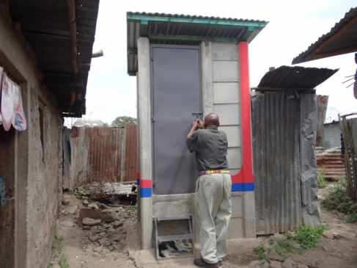
Water Sector Trust Fund
Sanitation Team Training workshop
What is sanitation?
The Sanitation Value Chain
Sanitation in urban Kenya
Main sanitation challenges
Your role in sanitation
Version:2.0
Last Update: August 2017

Slide 2
Introducing sanitation?
According to you, what is Sanitation?

Slide 3
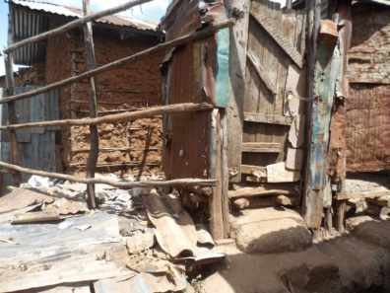
What is sanitation?
Sanitation is the hygienic means of promoting health through prevention of human contact with wastes as well as the treatment and proper disposal of waste
Hazards can be agents of disease. Wastes that can cause health problems include human and animal faeces, solid waste , domestic wastewater and agricultural wastes

Slide 4
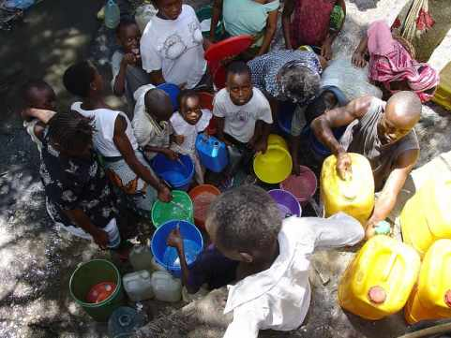
Sanitation, continued
Hygienic means of prevention can be by using solutions such as treatment facilities (e.g. sewerage and wastewater treatment) or simple technologies (construction of toilets), or even by personal hygiene practices (e.g. simple hand washing with soap and water )

Slide 5
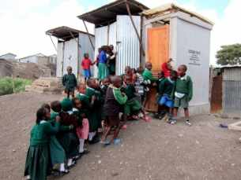
Sanitation, continued
According to the World Health Organisation (WHO):
“Sanitation” generally refers to the provision of facilities and services for the safe disposal of human urine and faeces.
The word “sanitation” also refers to the maintenance of hygienic conditions, through services such as garbage collection and wastewater disposal”

Slide 6
What is sanitation?
The term "sanitation" is applied to a wide range of subjects such as:
Improved sanitation - refers to the management of human faeces at the household level.
On-site sanitation - the collection and treatment of waste is done where it is deposited. Examples are the use of septic tanks or dry toilets (particularly in rural areas)

Slide 7
What is sanitation?
The term "sanitation" is applied to a wide range of subjects such as:
Environmental sanitation - Activities aimed at improving or maintaining the standard of basic environmental conditions affecting the well-being of people. This include the control of environmental factors that form links in disease transmission such as solid waste management, water and wastewater treatment
Ecological sanitation - an approach that recycles nutrients and water from human and animal wastes in a hygienically safe manner

Slide 8
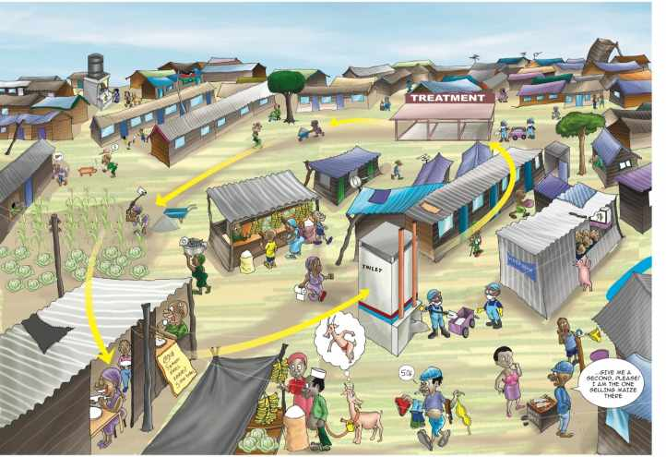
The Sanitation Value Chain
What do you understand from this poster? (Lets discuss this!)

Slide 9
What does the poster tell you about sanitation?
1.
2.
3.
What opportunities did you see from the poster?
1.
2.
3.

Slide 10
Sanitation situation in urban Kenya
Urban sanitation coverage figures
No. | Facility | % use
1. | Traditional Pit Latrine | 42.17
2. | Improved Pit Latrine | 18.37
3. | Pour Flush Toilets | 12.43
4. | Toilet Linked to Septic Tank | 7.80
5. | Toilet Linked to Sewer | 6.94
6. | Public (Fee Paying) Facility | 4.04
7. | Other Sanitation Facility | 3.85
8. | Ventilated Improve Pit Latrine | 2.29
9. | Open defecation (OD) | 1.53
10. | Flying Toilets | 0.39
11. | Others (Biogas, UDT, Open Discharge | 0.18
Sanitation facilities and practice used in Kenya’s urban low income areas (Source: MajiData)

Slide 11
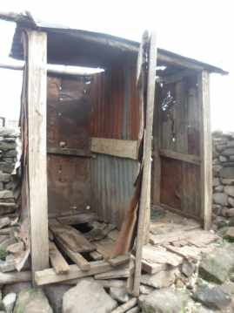
Sanitation challenges in Kenya
Main sanitation challenges are:
Low access to sanitation at the household/plot levels
Limited network of sewer systems
Few water companies with functioning wastewater treatment plants
Poor designs of toilets (see picture) →→

Slide 12
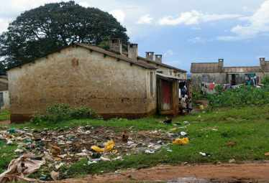
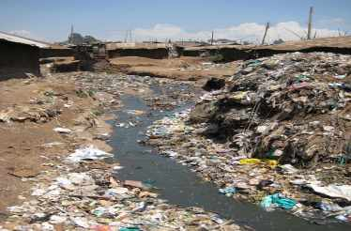
Sanitation challenges in Kenya
Main sanitation challenges are:
Lack of water
Poor sanitation monitoring
Urban low income areas were ignored by the government
Lack of space in densely populated low income urban areas

Slide 13
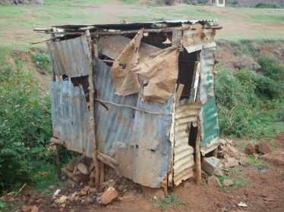
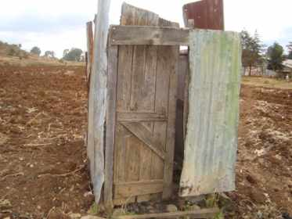
Sanitation situation in low income urban areas

Slide 14
How are such toilets in low income areas emptied?
Any ideas??

Slide 15
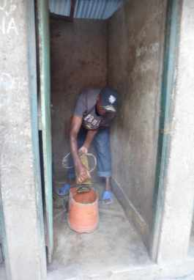
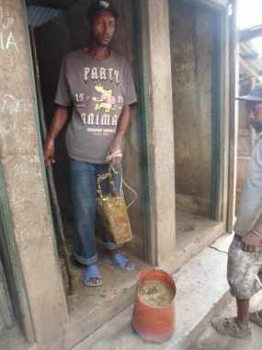
This is how the toilets are normally emptied ☹

Slide 16
How is the waste transported?
?

Slide 17
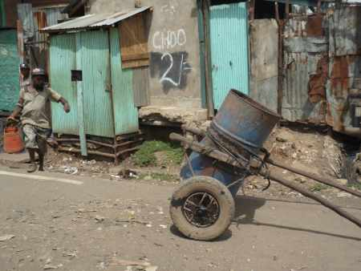
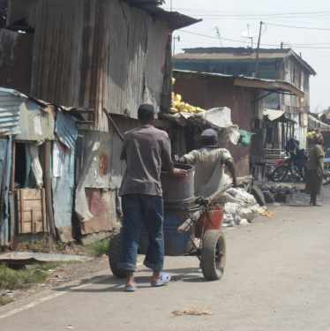
This is how the sludge is transported ☹

Slide 18
Where is the waste taken too?
?

Slide 19
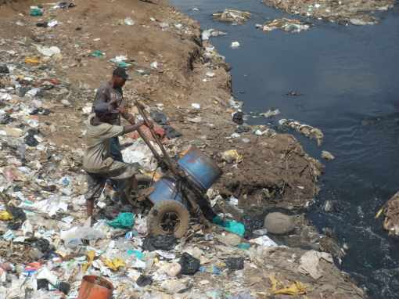
The waste is dumped in rivers or surface areas ☹

Slide 20
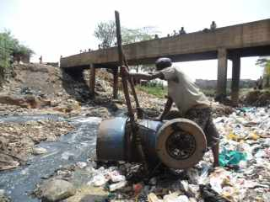
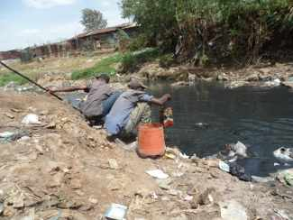
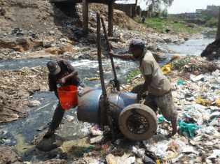
This happens in a lot of low income areas ☹ Is this good? What are the risks?

Slide 21
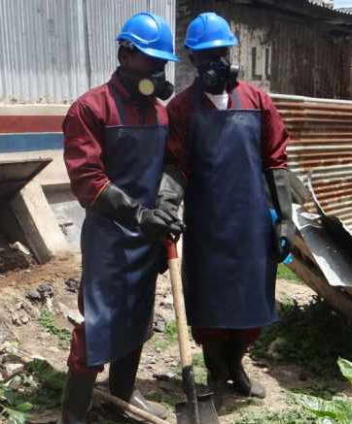
What is your role in sanitation? (1)
You will be part of an amazing group called the Sanitation Team
You shall be the sanitation watch dogs for the health and the water sector to avoid illegal manual emptying
We shall equip you with protective equipment that you require
You shall only empty one type of toilet (UDDTs) where most of the treatment has occurred in the toilet
Notes:
Explain the UDDTs here already...and more illustrations!

Slide 22
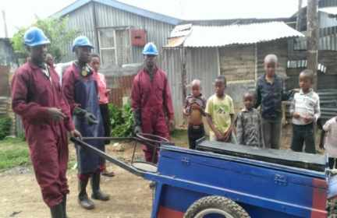
What is your role in sanitation? (2)
We shall assist you with posters to market yourself in the low income areas thus increasing business for you
We shall equip you with transportation equipment
You shall also be involved in solid waste management in the plots that have the SafiSan toilets
Notes:
Is the NEMA license budgeted bu WSTF???

Slide 23
What is your role in sanitation? (2)
We shall guide you to register, get certified and authorized in the public health department and apply for license’s at NEMA offices
We shall create awareness within the communities about the importance of your work therefore there shall be no stigmatisation
We shall advise you on the areas to dump the dry toilet waste
Notes:
Is the NEMA license budgeted bu WSTF???

Slide 24
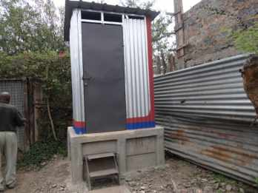
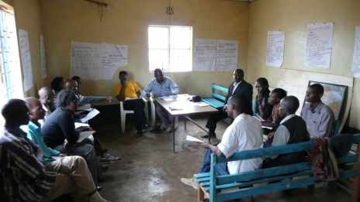

Thank You
Let us succeed together!

Slide 26


